Slide 1
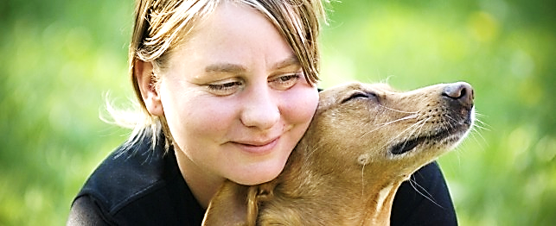
Puppy Love Faith pt.1
Called to be crazy in love with Jesus (About Praise & Worship)

Slide 2
Note: After you download the slideshow, you may also need to download some videos from YouTube & add them into this PowerPoint. This tool can help you: Free YouTube Download
We present these messages in outdoor venues using the SonShineTent. Watch the video of our service that goes with this message, click here: http://campaignkerusso.org/?p=13252
We would love to know more about the people who download our lessons & sermons. We invite you to email us & let us know where & how you use them.
info@campaignkerusso.org

Slide 3
Welcome All

Slide 4
Let’s Begin with Prayer

Slide 5
Song: Again I Say Rejoice
Video Goes Here Title: Again I Say Rejoice Download Here:
https://youtu.be/kt0ZKLMWoXM

Slide 6
Puppy Love Faith pt.1
Called to be crazy in love with Jesus (About Praise & Worship)

Slide 7
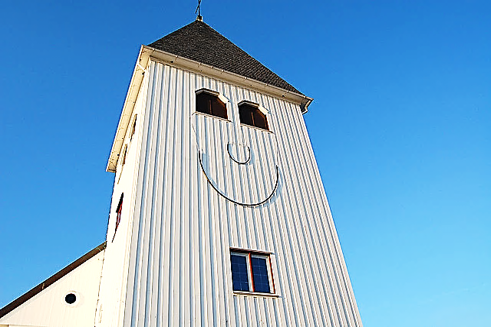
God wants
us to enjoy being
in
His presence.
“In Your presence
Lord is abundant joy”
Ps. 16:11 (HCSB)

Slide 8
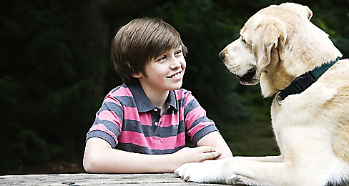
Puppies are happiest when they are in the presence of their masters.

Slide 9
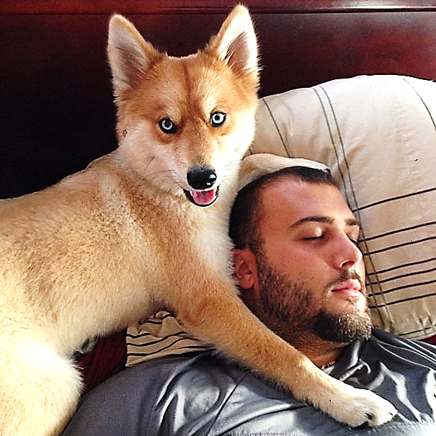
Puppies love their masters a whole lot.
How do we feel in the presence of God?

Slide 10
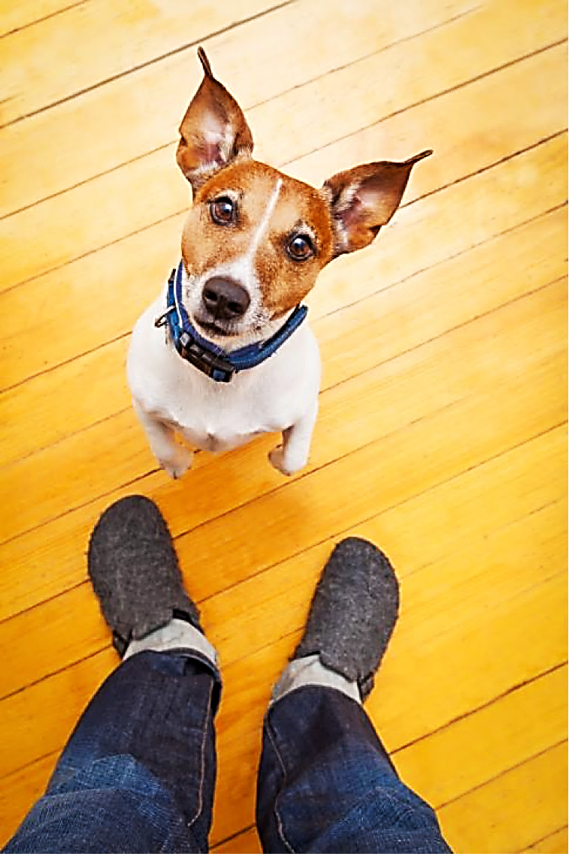
“Then I will worship at your altar because you make me joyful. You are my God, and I will praise you. Yes, I will praise you as I play my harp.” Psalm 43:4 (CEV)

Slide 11
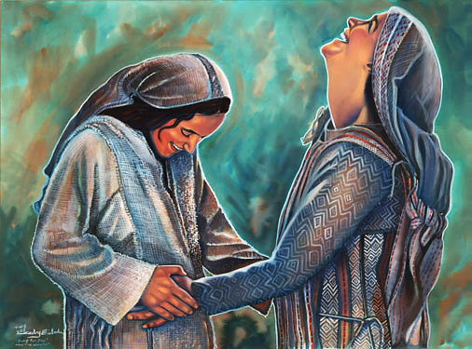
Even the unborn child, John the Baptist rejoiced
in the presence
of Jesus.
“At the sound of Mary’s greeting, Elizabeth’s child leaped within her… When I heard your greeting, the baby in my womb jumped for joy. Lk 1:41, 44 (NLT)

Slide 12
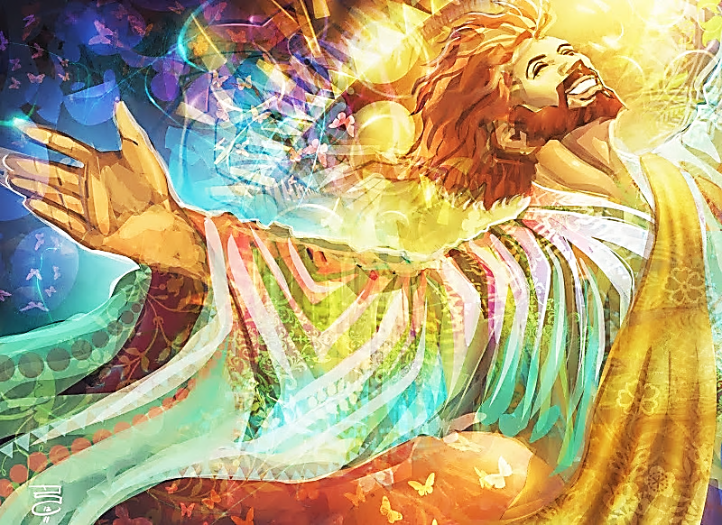
Even angels rejoice in His presence.
“Who put the first stone in its place when the morning stars sang together and the angels shouted with joy?” Job 38:7 (ERV)

Slide 13
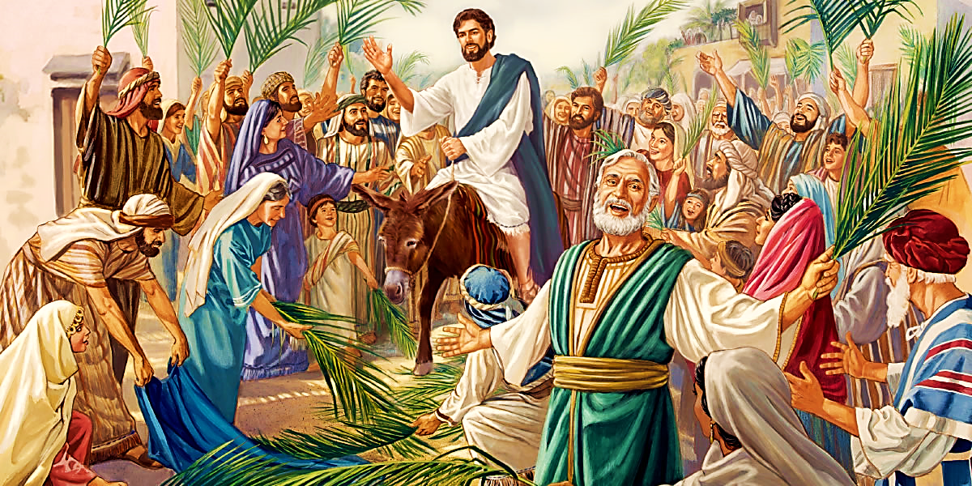
“Some of the Pharisees from the crowd said to Jesus, “Teacher, scold your disciples! Tell them to stop!” He answered, “I tell you, if they were silent, the stones would shout.” Luke 19:39-40

Slide 14
God Calls Entire Congregations to Worship in His House

Slide 15
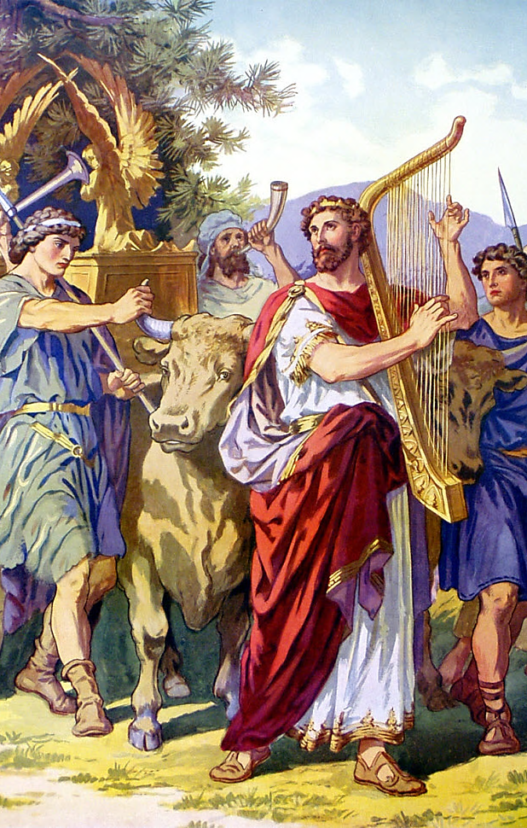
The Ark brought the presence of God into Israel and the people rejoiced openly just to have Him coming near.
“David and all the Israelites shouted with joy and blew the trumpets as they brought the Ark of the Lord to the city.”
2 Sam 6:15 (NCV)

Slide 16
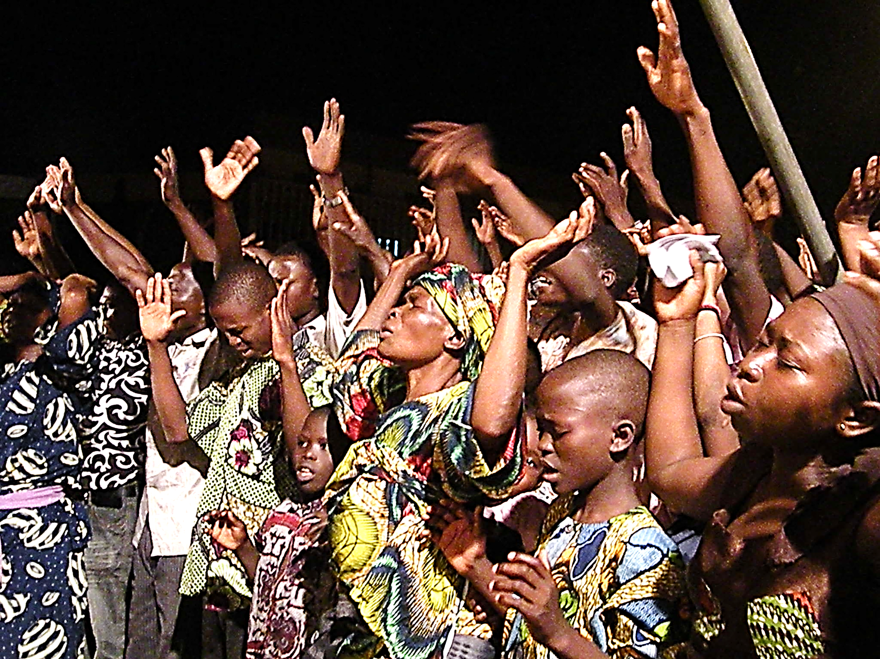
“Enter His gates with thanksgiving and His courts with praise. Give thanks to Him and praise His name.”
Psalm 100:4 (HCSB)

Slide 17
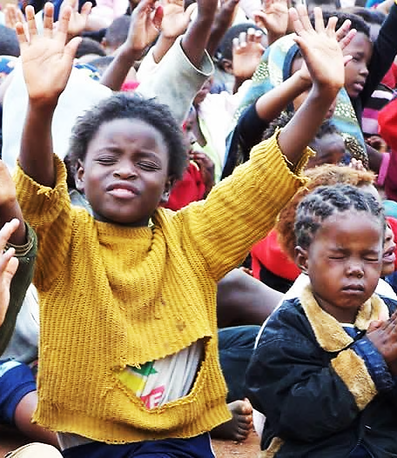
“Come, let us sing with joy to the Lord. Let us sing loud with joy to the rock Who saves us. Let us come before Him giving thanks. Let us make a sound of joy to Him with songs.”
Ps 95:1, 2 (NLV)
Worship Makes the Poor Rich

Slide 18
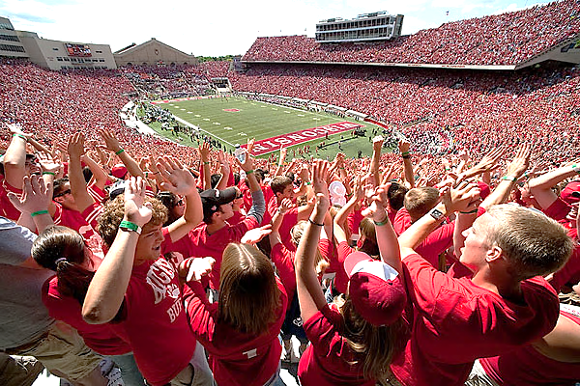
People enthusiastically celebrate many things (such as this ball game), but the presence of the Lord is more praise-worthy than anything The World has to offer.

Slide 19
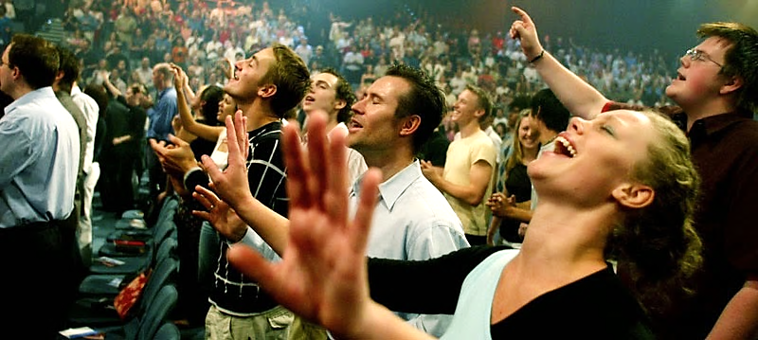
Entire Nations Are
Called to Worship Him
“God, you will make the nation grow, and you will make the people happy. They will rejoice in your presence as they do at harvest time…” Isa. 9:3 (ERV)

Slide 20
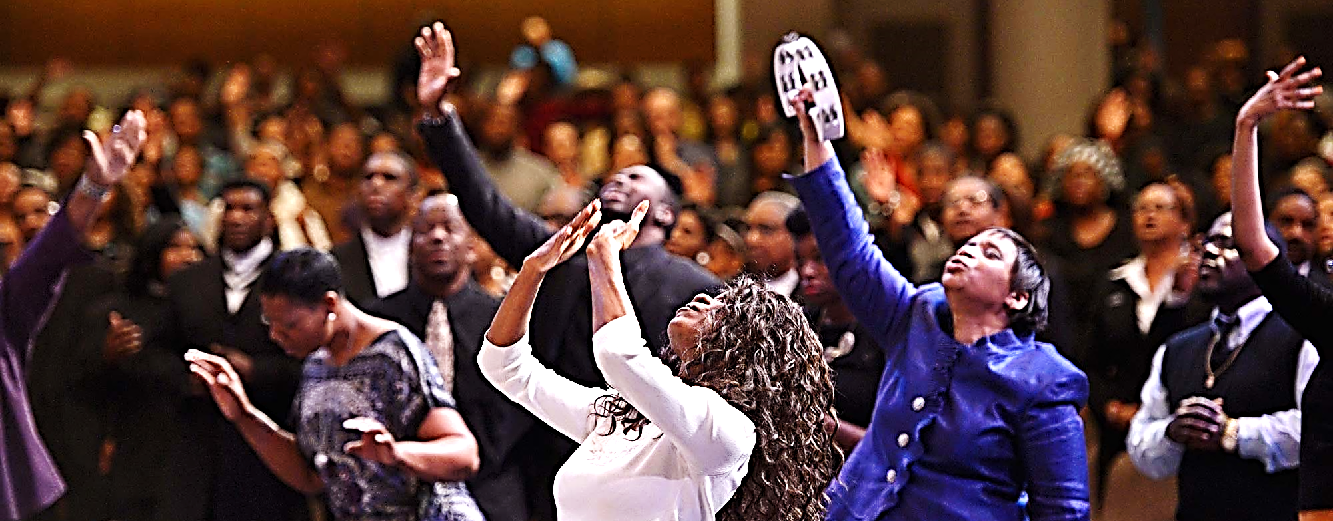
We are called to praise Him both in and out of our church services.
“Always be filled with joy in the Lord. I will say it again. Be filled with joy.”
Phil. 4:4 (ERV)

Slide 21
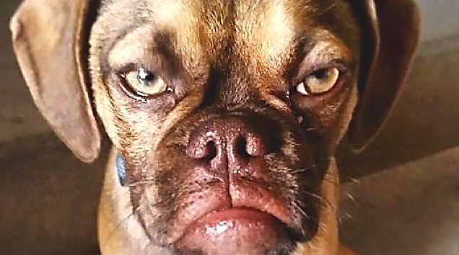
Sadly, some Christians don’t seem very joyful.

Slide 22
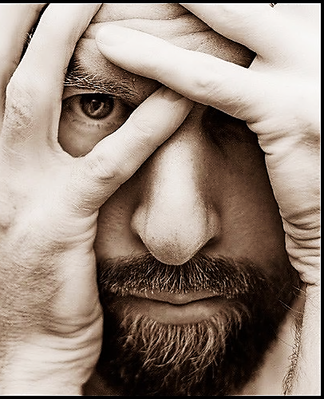
If we exhibit the works of the ‘Old Man’ rather than the Fruit of the Spirit (such as joy), we need to examine our hearts.

Slide 23
“The things your sinful old self wants to do are… hating, fighting, being jealous, being angry, arguing, dividing into little groups and thinking the other groups are wrong… But the fruit that comes from having the Holy Spirit in our lives is: love, joy (etc.)” Gal 5:19-22 (ICB)

Slide 24
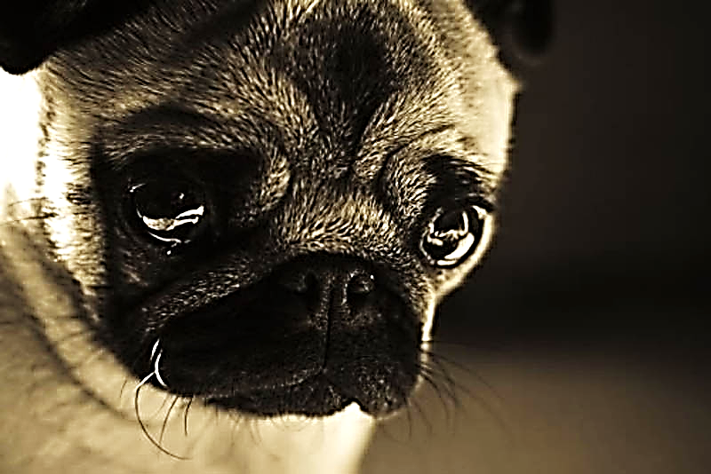
However, God Understands Times of Sorrow

Slide 25
If we are suffering, God
understands and says
we should pray.
We need to look
upwards for His
help in times
of trouble.
We don’t need to
grumble and complain..

Slide 26
“Is anyone among you suffering? He should keep on praying about it. And those who have reason to be thankful should continually be singing praises to the Lord.”
James 5:13 (ISV)

Slide 27
Our altars should be filled with believers who are either praying about their troubles or praising their Lord.

Slide 28
Is Jesus
Speaking to You?
“They said to each other, ‘Did not our hearts burn within us while he talked to us on the road, while he opened to us the Scriptures?’”
John Wesley Said:
“…the preacher was describing the change which God works in the heart through faith in Christ and I felt my heart strangely warmed.”
Jesus makes His presence Known by a small voice!

Slide 30
What is the Sinner‘s Prayer?
This is a prayer we can pray when we are ready to admit we are sinners and need Christ’s forgiveness.
It must be prayed with faith in our hearts and a readiness to have a life-changing encounter with Jesus Christ.

Slide 31
A prayer of faith → Pray this prayer if :
If you never have before
You have in the past, but you think it would mean more today
You have been walking afar off and you want to come back
You want to set an example & show others how it is done
You just like to give your heart to Jesus again & again
Faith

Slide 32
We Declare Our Faith Publicly Because Jesus Declared His LOVE Publicly
“If you stand before others and are willing to say you believe in me, then I will tell my Father in heaven that you belong to me.” Mat 10:32

Slide 33
Three Important Questions
Do you want to know Jesus as your Savior right now?
Do you believe He died to save you from your sins & that He rose from the dead?
Do you believe that He is here, waiting to save you right now?

Slide 34
The Prayer of a Sinner Turning to Jesus
Dear Jesus, I know that I have sinned against You and that my sins separate me from You.
I am truly sorry.
Right now, I turn away from my sinful past .
Please forgive me, and help me to keep from sin.
I believe You died for my sins.
I Believe You rose from the dead, you are alive, and you hear this prayer from my heart.
I invite You Jesus to be both my Savior and the Lord of my life.
I want You to rule my life from now on.

Slide 35
“But some people did accept him. They believed in him, and he gave them the right to become children of God.”
John 1:12

Slide 37
“If you openly say, ‘Jesus is Lord’ and believe in your heart that God raised him from death, you will be saved.”
Rom. 10:9
What did you learn today?
What about praise and Worship?
What have you been thinking about God lately?
What do you want to tell others about Jesus?

Slide 38
Song: Ain’t No Rock
Video Goes Here Title: Ain’t No Rock Download Here:
https://youtu.be/tVKG96Xc2lQ

Slide 39
Let’s Close in Prayer

Slide 40
Note: After you download the slideshow, you may also need to download some videos from YouTube & add them into this PowerPoint. This tool can help you: Free YouTube Download
We present these messages in outdoor venues using the SonShineTent. Watch the video of our service that goes with this message, click here: http://campaignkerusso.org/?p=13252
We would love to know more about the people who download our lessons & sermons. We invite you to email us & let us know where & how you use them.
info@campaignkerusso.org

